Slide 1
An Evaluation of Distributed Concurrency Control
Paper authored by Rachael Harding et al.
Presented by Uzair Inamdar

Slide 2
What We’ll Cover
Introduction
Protocols Being Tested
Test and Architectural Overview
Tests
Contention
Update Rate
Multi-Partition Transactions
Scalability
Network Speed
Points to Consider
Conclusion

Slide 3
Introduction
Evaluation of performance of protocols across various tests.
Rise of Distributed Database Management Systems (DBMS)
Data Partitioning
Serializability
Deneva
Deployed on Amazon EC2 with 8 virtualized CPU cores and 32 GB of memory
Notes:
Extreme growth of data queries that made it impossible for single server databases to handle.
Portioning across servers improves throughput by letting transactions run in parallel.
Serializability is the classical concurrency scheme. It ensures that a schedule for executing concurrent transactions is equivalent to one that executes the transactions serially in some order.
Deneva is a lightweight testing framework that ensures a fair comparison.

Slide 4
Protocols Being Tested
Two Phase Lock (2PL)
NO_WAIT
WAIT_DIE
Timestamp Ordering
TIMESTAMP
Multi-Version Concurrency Control (MVCC)
Optimistic Concurrency Control (OCC)
Deterministic (CALVIN)

Slide 5
Tests Overview
Only serializable executions are analyzed.
Online Transaction Processing are done through thread-safe sockets over TCP/IP.
The queries are executed by 4 threads in a non-blocking manner unless a shared resource is being worked on.
No logging, checkpoint, and recovery.
Table partitions are preloaded on servers.
Each server will carry 10,000 open client connection.
When a transaction aborts, it restarts after a penalized period.

Slide 6
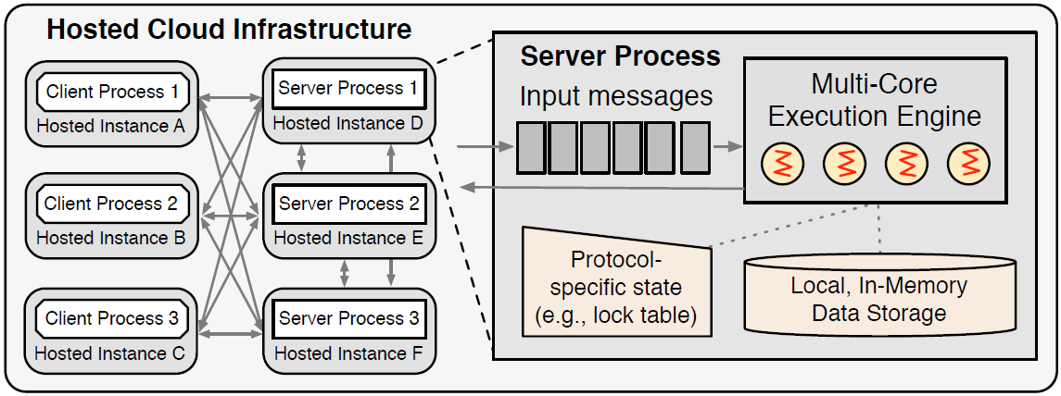
Architectural Overview
Each server can host more than one partition, but each partition exists only on one server.
Does not provide replication or fault tolerance.

Slide 7
TESTS

Slide 8
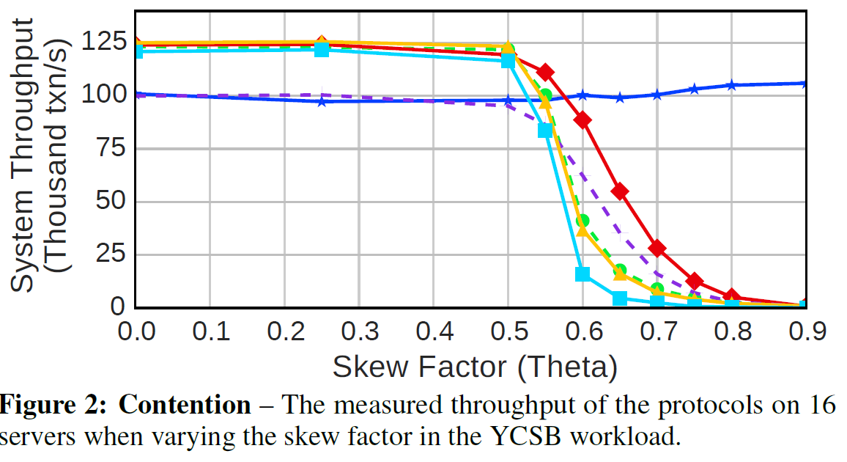
Contention

Slide 9
1. Contention
CALVIN is initially bottlenecked because of thee single threaded schedulers, but it is the only protocol to maintain good performance despite high skew.
This is because locks are released much quicker once the read data is made available.
OCC performs badly under low contention due to the overheads of copy and validation even when chances of modifications are the least.
However, at higher levels the benefit of tolerating more conflicts and thus avoiding unnecessary aborts outweighs these overheads.
The rest have a steep drop because of excessive wait times caused by data locks.
Notes:
Explain Skew factor
Provide example for CALVIN

Slide 10
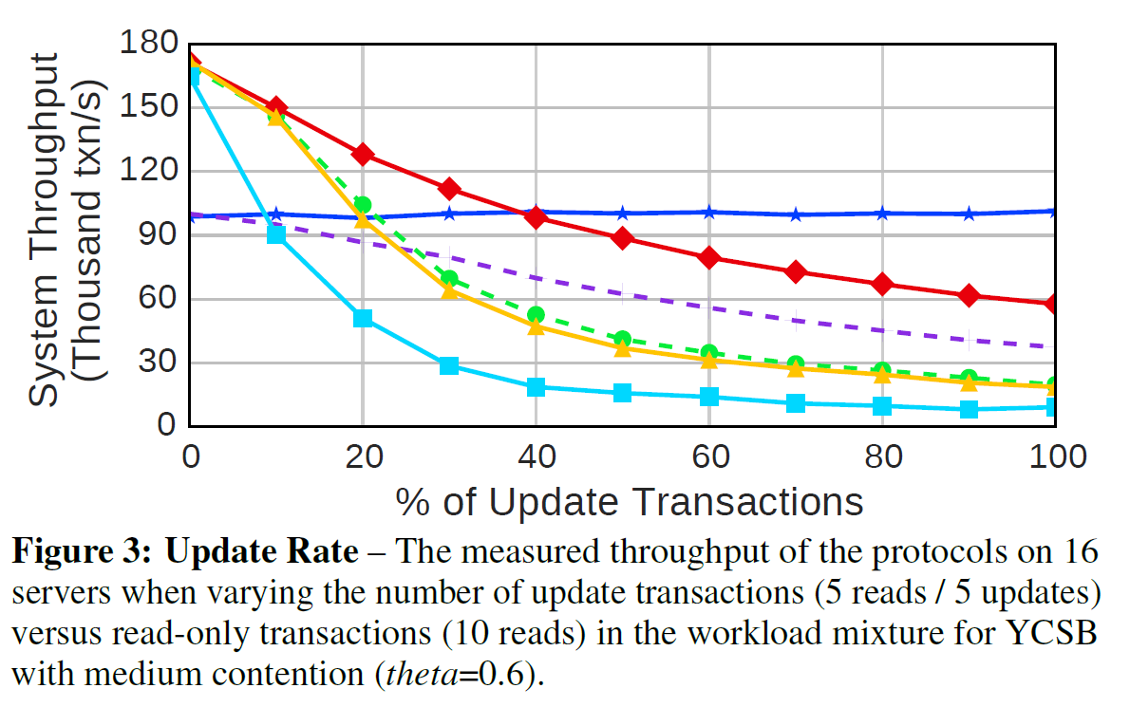
Update Rate

Slide 11
2. Update Rate
As the update% goes up, WAIT_DIE drops drastically and more transaction get queued into wait state as hot records are locked by various transactions.
These transactions waste a lot of resource because they non-deterministically bypass the queues and prolong the natural flow of transactions. Even after all this waiting, they grow old and are aborted.
NO_WAIT on the other hand is not affected because there is no waiting. The transactions abort straight away if the lock is not available.
TIMESTAMP and MVCC suffer from the wait time caused by locks that are held by active transactions.
OCC suffers from lower rates initially due to unnecessary validation checks, but at higher update% it is relatively faster as locks are not acquired.
CALVIN's advantage and disadvantage from contention carry over to update rates.

Slide 12
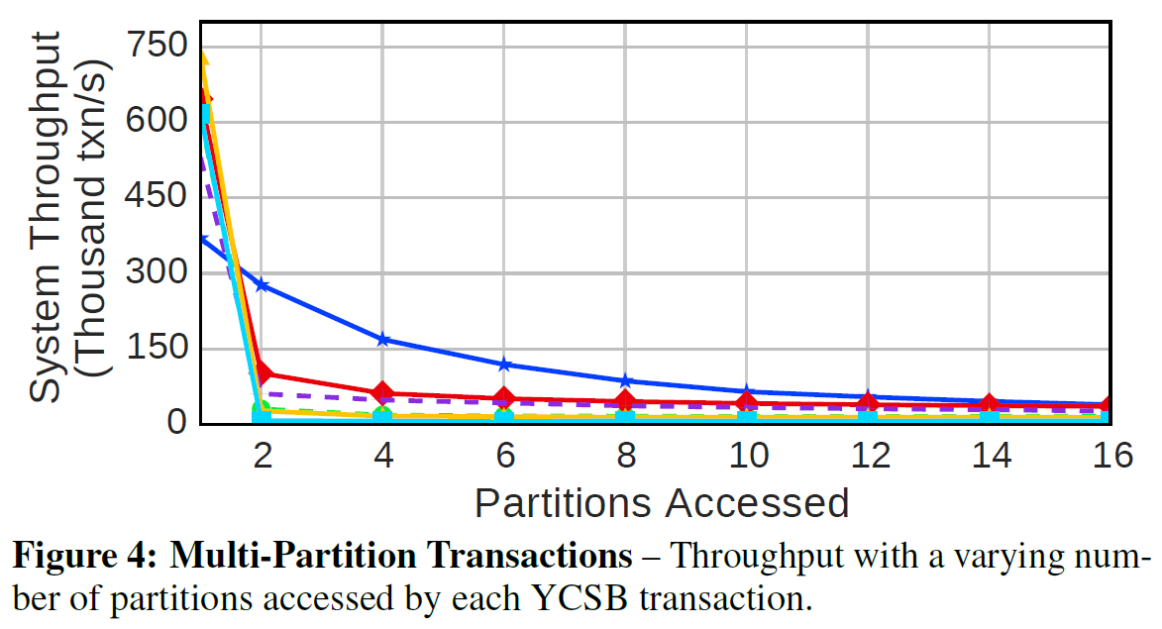
Multi-Partition Transactions

Slide 13
3. Multi-Partition Transactions
Pretty much all protocols plummet equally except CALVIN.
Part of the reason is because CALVIN does not make use of 2 Phase Commit protocol (2PC).
There is also the overhead caused by multiple requests and responses between different server messages.
CALVIN on the other hand synchronizes its schedulers every 5ms and hence the transactions are automatically forwarded to the target partitions.

Slide 14
4. Scalability

Slide 15
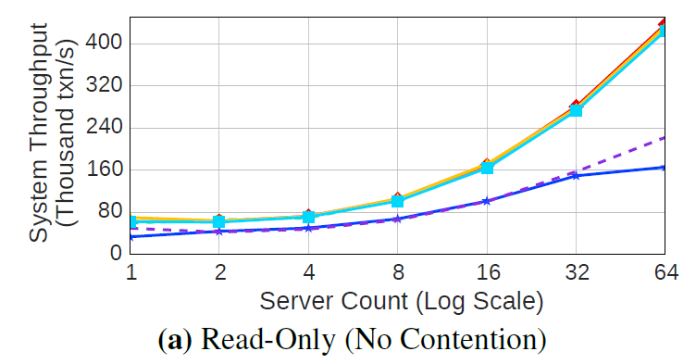
A) Read-only Workload
Notes:
Amost all protocols scale brilliantly except OCC and CALVIN because of their respective overheads caused by validation and scheduler.

Slide 16
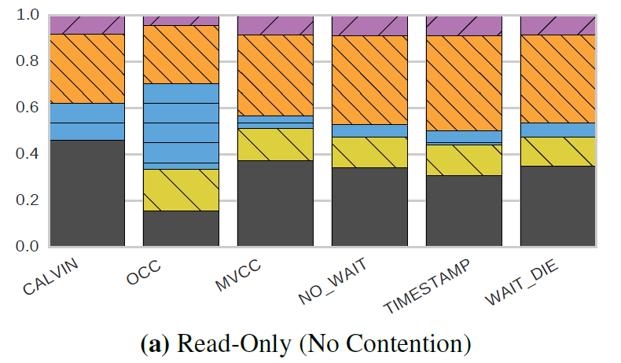
Time % Graph
Time %

Slide 17
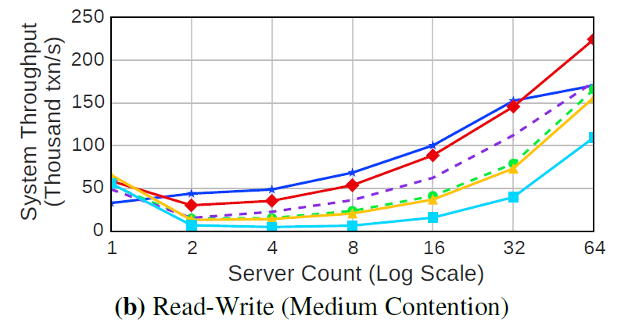
B) Read-Write (Medium Contention)
Notes:
Even though CALVIN shows the best improvement in single node on node increase, NO_WAIT has the best overall performance.
This is because of the lack of waiting of transactions for locks to be released, as a transaction is aborted immediately if the entry it's trying to access is blocked.
OCC also performs surprisingly well as the benefit of being able to tolerate more conflicts exceeds the costs of copying and validation.
TIMESTAMP and WAIT_DIE have the worst because of the time each transaction takes waiting for the locks to be released.

Slide 18
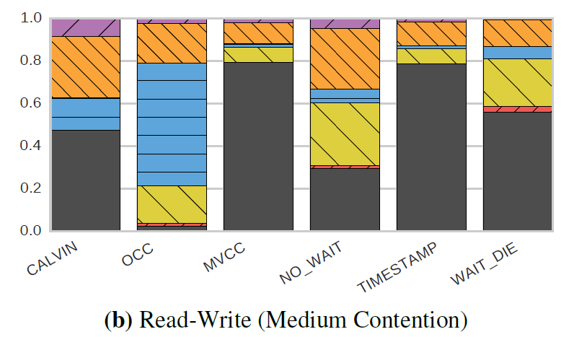
Time % Graph
Time %

Slide 19
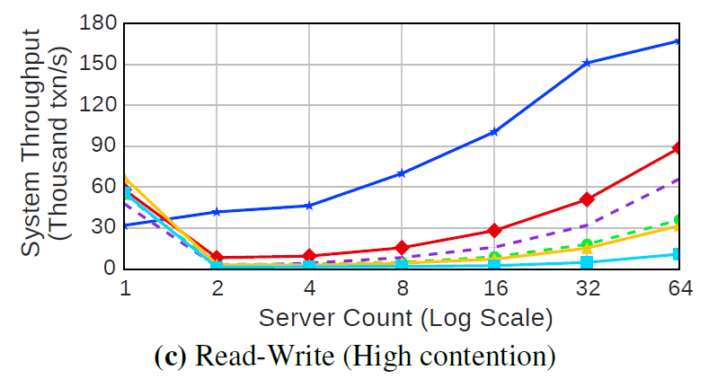
C) Read-Write (High Contention)
Notes:
CALVIN performs exceptionally well because as we have seen, it is not affected by the increase in amount of contention.
The problems lies with the protocols where they start to get bogged down by increasing wait time.
It is important to keep in mind that a lot of protocols that employ 2PL are sensitive to platform constraints like the number of requests allowed and the back-off penalty, which can be adjusted to make conditions favorable for each protocol.

Slide 20
Time % Graph
Time %

Slide 21
5. Network Speed
Protocols that use 2PC strategy experienced the most loss in throughput as the commits required delivery of transactional messages.
CALVIN does not need to exchange any messages between servers between its read and write phase. Hence, it performs the best.
WAIT_DIE sees the worst performance as not only are the messages being lagged, the lagging is causing a lot of the waiting transactions to age and abort. The high abort rate in the main reason for the significant loss in performance.
TIMESTAMP and MVCC also suffer loss in performance because of delay in transactional messages, but don't suffer as bad a rate for aborts.
Notes:
To test the effect of network speed, artificial network delay was inserted to buffer the messages sent from clients to servers.

Slide 22
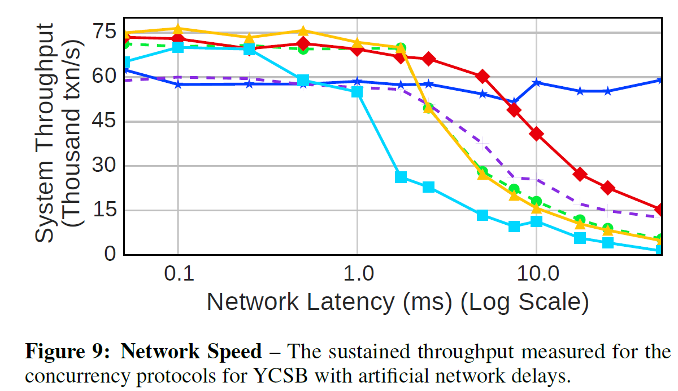
Network Speed
Notes:
To test the effect of network speed, artificial network delay was inserted to buffer the messages sent from clients to servers.
Protocols that use 2PC strategy experienced the most loss in throughput as the commits required delivery of transactional messages.
CALVIN does not need to exchange any messages between servers between its read and write phase and depends on the schedulers. Hence, it performs the best.
WAIT_DIE sees the worst performance as not only are the messages being lagged, the lagging is causing a lot of the waiting transactions to age and abort. The high abort rate in the main reason for the significant loss in performance.
TIMESTAMP and MVCC also suffer loss in performance because of delay in transactional messages, but don't suffer as bad a rate for aborts.

Slide 23
Points to Consider
Effect of platform constraints on protocols
Number of requests allowed
The back-off penalty
Number of Servers/Partitions
Type of Transactions
Testing on Transaction Processing Performance Council - Type C (TPC-C)
Notes:
CALVIN was designed specifically to try to mitigate the affects of 2PC.

Slide 24
Conclusion
2PL performs poorly under high contention due to aborts.
Timestamp-ordered concurrency control does not perform well under high contention due to buffering.
Optimistic concurrency control has validation overhead.
Deterministic protocol maintains performance across a range of adverse load and data skew but has limited performance due to transaction scheduling.
There exists a serious scalability problem, especially when the partitions do not exist in a single data center.
Possible Solution
Notes:
To tightly couple concurrency control engines.
Improve the network and Adapt to the data model.

Slide 25
Thank You

